Slide 1

UNIVERSITY INSTITUTE OF ENGINEERING
DEPARTMENT OF AIT - CSE
Bachelor of Engineering (CSE)
Advanced Programming (20CST-337)
By: Rahul Rathore(E12904)
Lecture -2
Range Minimum Query, Lowest Common Ancestor, Tries,
DISCOVER . LEARN . EMPOWER

Slide 2
Chapter | Course Objectives
1. | This subject aims to focuses on Advanced concept of C++ and advanced data structure to students. It focuses on advanced level analysis of algorithm and computational mathematics.
Chapter | Course Outcomes
1. | Explain the data structure and OOPS concepts using C++. Apply the shortest path and minimum spanning algorithms in computer networks. Examine the complexity of searching and sorting algorithms, and optimization through arrays, linked structures, stacks, queues, trees, and graphs. Decide and implement an appropriate graph algorithm and hashing function in computer networks for data security. Construct security encryption and decryption algorithms using computational mathematics and graph algorithm.

Slide 3
Data Structures: Range Queries - Space Efficiency

Slide 4
Range Minimum Queries
Database systems
Lowest average-salary:
Year
1990 | 1995 | 2000 | 2005 | 2010
60
50
40
30
20
80,000 | 85,000 | 115,000 | 120,000 | 118,000
81,000 | 73,000 | 90,000 | 100,000 | 94,000
65,000 | 75,000 | 86,000 | 92,000 | 95,000
72,000 | 91,000 | 89,000 | 103,000 | 102,000
35,000 | 45,000 | 42,000 | 50,000 | 41,000
Age
Minimum:
65,000 at [3,1]

Slide 5

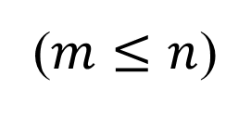

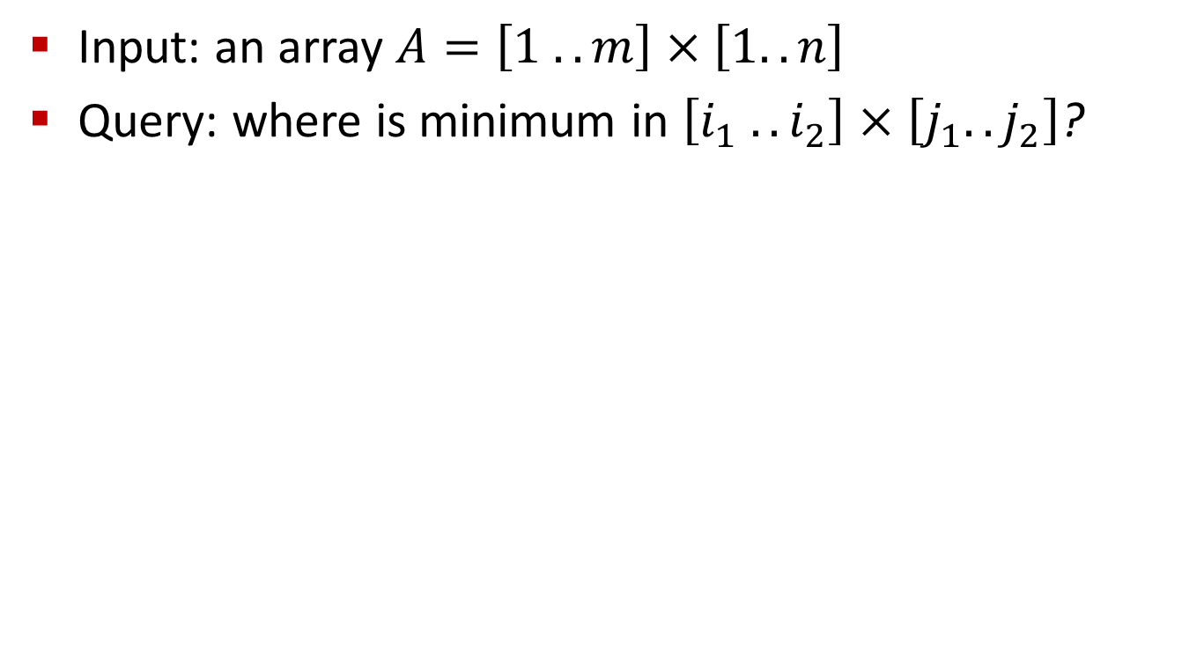




Definition
($m≤n$)
Input: an array $A=\left[1 .. m\right]×\left[1..n\right]$
Query: where is minimum in $\left[i_{1} .. i_{2}\right]×\left[j_{1}..j_{2}\right]$?
$$n$$
$$i_{1}$$
$$m$$
$$i_{2}$$
$$j_{1}$$
$$j_{2}$$

Slide 6

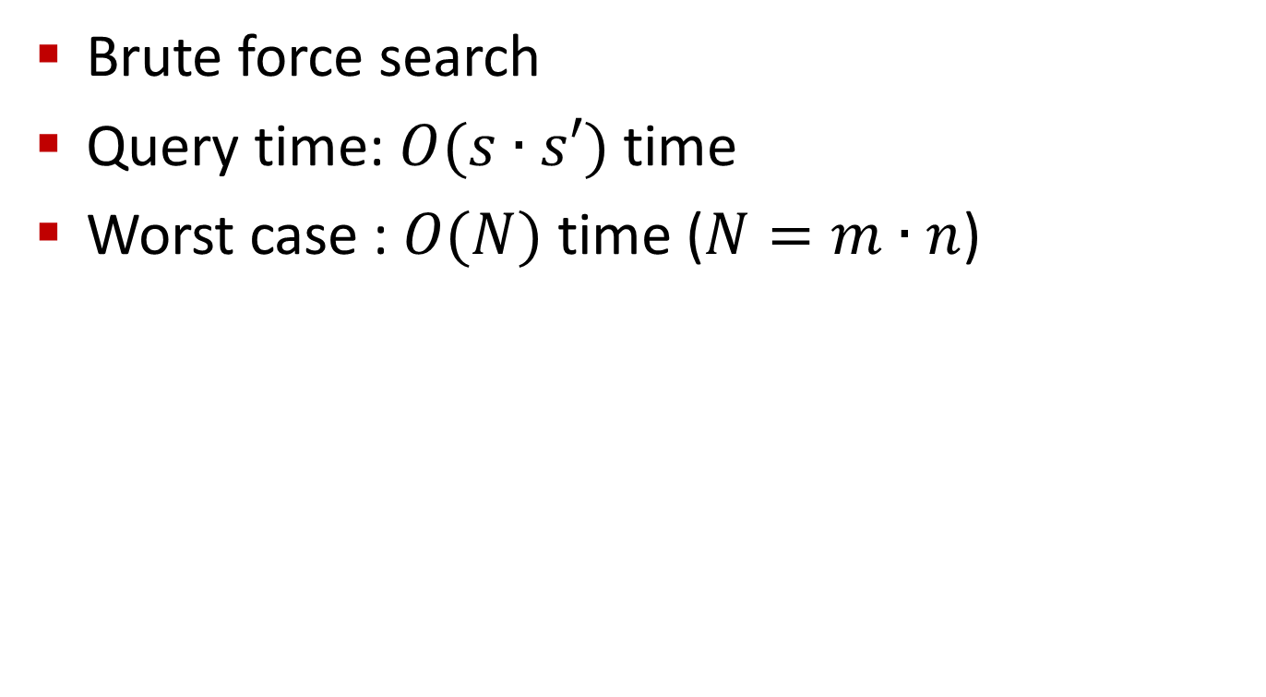



Naïve Solution
Brute force search
Query time: $O(s∙s′)$ time
Worst case : $O(N)$time ($N=m∙n$)
$$n$$
$$s′$$
$$m$$
$$s$$

Slide 7

Data Structures
Preprocess and store some information
Naïve: store the answers of all queries
$O(1)$ query time
Size of the table:
$O(N^{2}\log{N})$ bits
Top-Left | Bottom-Right | Minimum
(1,1) | (1,1) | (1,1): 12
(1,1) | (1,2) | (1,2): 8
(1,1) | (2,1) | (2,1): 5
(1,1) | (2,2) | (2,1): 5
(2,1) | (2,1) | (2,1): 5
(2,1) | (2,2) | (2,2): 5
(1,2) | (1,2) | (1,2): 8
(1,2) | (2,2) | (1,2): 8
(2,2) | (2,2) | (2,2): 10
1 | 2
12 | 8
5 | 10
1
2
Tabulation

Slide 8
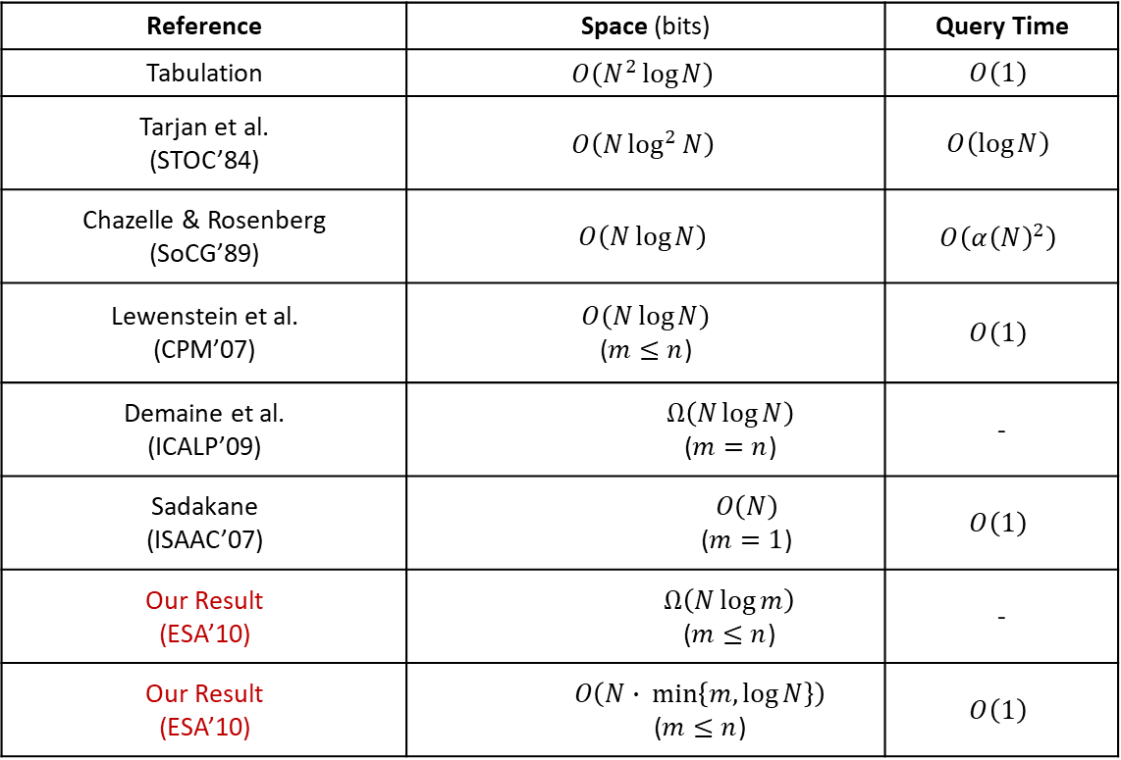
Space-Efficient Data Structures
Reference | Space (bits) | Query Time
Tabulation | $$O\left(N^{2}\log{N}\right)$$ | $$O\left(1\right)$$
Tarjan et al. (STOC’84) | $$O\left(N\log^{2}{N}\right)$$ | $$O\left(\log{N}\right)$$
Chazelle& Rosenberg (SoCG’89) | $$O\left(N\log{N}\right)$$ | $$O\left({α\left(N\right)}^{2}\right)$$
Lewenstein et al. (CPM’07) | $$O\left(N\log{N}\right)$$ ($m≤n$) | $$O\left(1\right)$$
Demaine et al. (ICALP’09) | $$Ω\left(N\log{N}\right)$$ ($m=n$) | -
Sadakane (ISAAC’07) | $$O\left(N\right)$$ ($m=1$) | $$O\left(1\right)$$
Our Result (ESA’10) | $$Ω\left(N\log{m}\right)$$ ($m≤n$) | -
Our Result (ESA’10) | $$O\left(N∙ min\left\{m,log{N}\right\}\right)$$ ($m≤n$) | $$O\left(1\right)$$
Notes:
How to improve from Tarjan to Lewenstein and to ours?

Slide 9

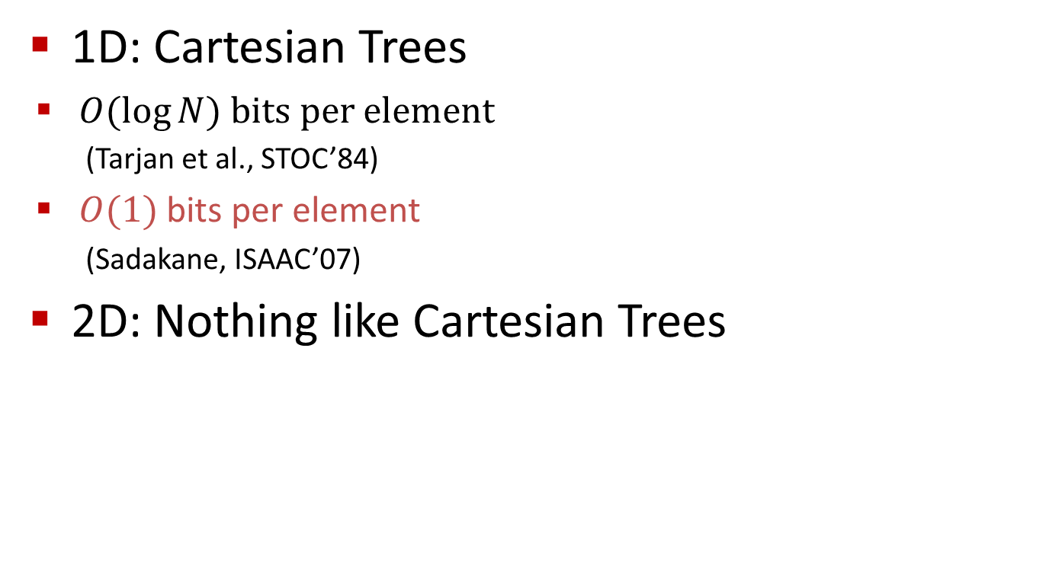
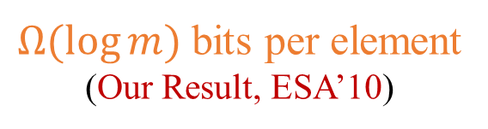
1D vs. 2D
2
Lowest Common Ancestor
1D: Cartesian Trees
$O(\log{N})$ bits per element
(Tarjan et al., STOC’84)
$O(1)$ bits per element
(Sadakane, ISAAC’07)
2D: Nothing like Cartesian Trees
7
5
20
8
6
10
16
7 | 20 | 2 | 10 | 8 | 5 | 16 | 6
$Ω(\log{m})$ bits per element
(Our Result, ESA’10)
$$m$$

Slide 10
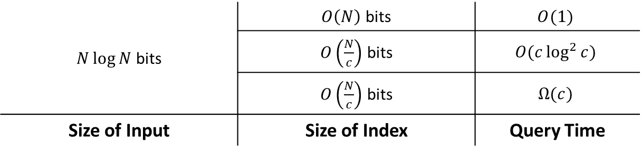


Indexing Data Structures
Popular in Succinct Data Structures
Read-only
Input Array $$m×n=N$$
Index
$\left\{\begin{matrix}O(1) \\ O\left(\frac{1}{c}\right)\end{matrix}\right.$ bits per element
$N\log{N}$ bits | $O\left(N\right)$ bits | $$O(1)$$
 | $O\left(\frac{N}{c}\right)$ bits | $$O(c\log^{2}{c})$$
 | $O\left(\frac{N}{c}\right)$ bits | $$Ω(c)$$
Size of Input | Size of Index | Query Time
(Our Results, ESA’10)

Slide 11
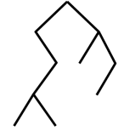

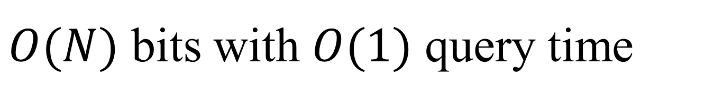



$O(N)$ bits with $O(1)$ query time
2
27 | 30 | 2 | 90 | 28 | 15 | 18 | 6
13 | 20 | 93 | 54 | 17 | 11 | 16 | 12
7 | 74 | 39 | 62 | 8 | 5 | 46 | 23
61 | 38 | 68 | 10 | 9 | 87 | 98 | 21
7
5
Cartesian Trees
20
8
6
10
16
7 | 20 | 2 | 10 | 8 | 5 | 16 | 6
Cartesian Tree:
$$\log{n}$$
$$\log{\log{n}}$$
$$\log{\log{m}}$$
$$\log{m}$$
Tabulation
Atallah and Yuan (SODA’10)

Slide 12

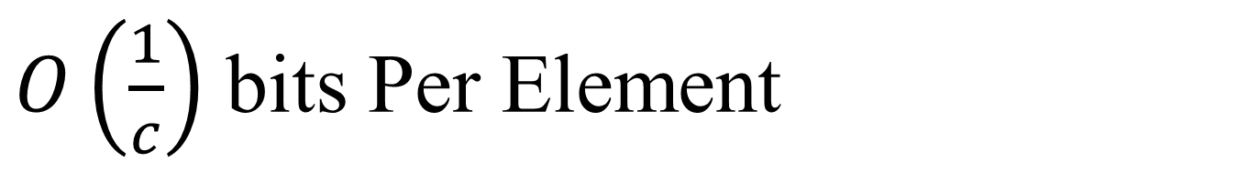
$O\left(\frac{1}{c}\right)$ bits Per Element
$N/c$ bits $O(c\log^{2}{c)}$ query time
$N/c$bits $Ω(c)$query time
Proof: $N/c$queries distinguish inputs in $Ω(N)$ time
$∃$query with $Ω(c)$ time
C
1 | 1 | 0 | 1 | 1 | 1 | 1 | 1 | 1 | 0 | 1 | 1 | 1 | 0 | 1 | 0 | 1 | 1 | 1 | 1
1 | 0 | 1 | 1 | 1 | 0 | 1 | 1 | 1 | 1 | 1 | 1 | 1 | 1 | 0 | 1 | 0 | 1 | 1 | 1
1 | 1 | 1 | 0 | 1 | 1 | 0 | 1 | 1 | 1 | 1 | 1 | 1 | 0 | 1 | 1 | 1 | 0 | 1 | 1
1 | 1 | 1 | 1 | 0 | 1 | 1 | 0 | 1 | 1 | 1 | 1 | 0 | 1 | 1 | 1 | 1 | 0 | 1 | 1
0 | 1 | 1 | 1 | 1 | 1 | 1 | 0 | 1 | 1 | 1 | 0 | 1 | 1 | 1 | 1 | 1 | 1 | 1 | 0
1 | 0 | 1 | 1 | 1 | 1 | 0 | 1 | 1 | 1 | 0 | 1 | 1 | 1 | 1 | 1 | 0 | 1 | 1 | 1

Slide 13
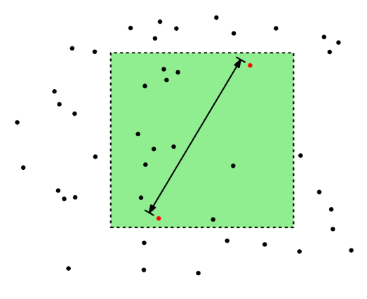
Outline
Range Minimum Queries (ESA 2010, Invited to Algorithmica)
Path Minima Queries (WADS 2011)
Range Diameter Queries (Submitted to ISAAC 2011)
25 | 12 | 6 | 8 | 10 | 65 | 7 | 13
12 | 43 | 76 | 31 | 17 | 62 | 9 | 5
14 | 23 | 18 | 79 | 84 | 10 | 8 | 40
4 | 6 | 98 | 45 | 11 | 38 | 58 | 25
4
6
7
20
4
2
3
10
5
4

Slide 14
Path Minima/Maxima Queries
The most expensive connection between two given nodes?
between b and k = (c,e)
between e and k = (j,k)
Update(c,e) = 4
i
4
30
4
6
7
e
j
c
3
b
4
2
10
5
4
h
f
g
a
d
k
Tree-Topology Networks
Trees with Dynamic Weights

Slide 15
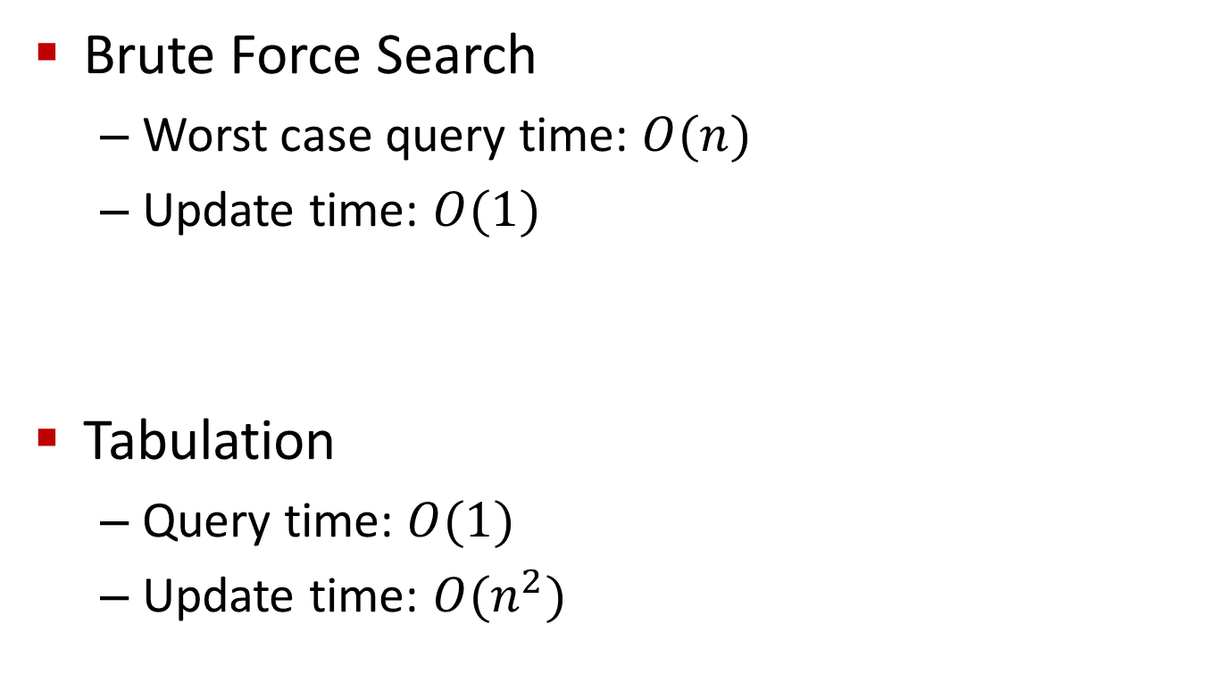
Naïve Structures
Brute Force Search
Worst case query time: $O(n)$
Update time: $O(1)$
Tabulation
Query time: $O(1)$
Update time: $O(n^{2})$
i
4
30
e
6
j
7
c
3
b
4
2
5
4
h
10
f
g
a
d
k
30
4

Slide 16



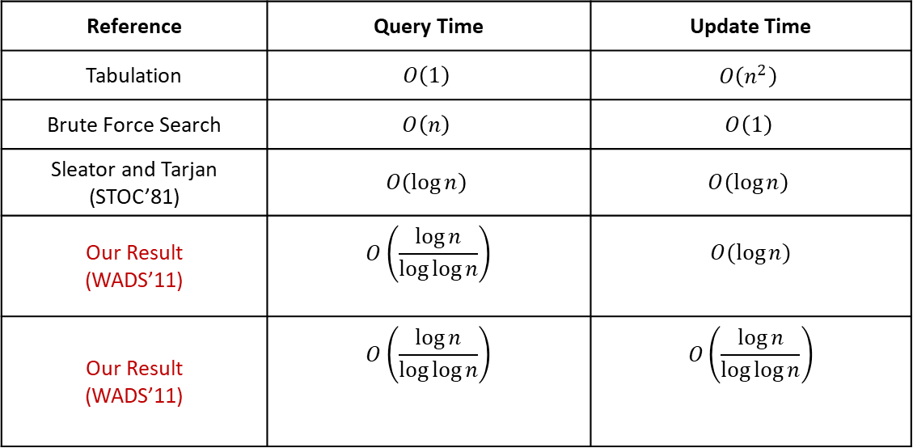



Dynamic Weights
Reduction from Range Minimum Queries in 1D arrays
Reference | Query Time | Update Time
Tabulation | $$O\left(1\right)$$ | $$O\left(n^{2}\right)$$
Brute Force Search | $$O\left(n\right)$$ | $$O\left(1\right)$$
Sleator and Tarjan (STOC’81) | $$O\left(\log{n}\right)$$ | $$O\left(\log{n}\right)$$
Our Result (WADS’11) | $$O\left(\frac{\log{n}}{\log{\log{n}}}\right)$$ | $$O(\log{n})$$
Our Result (WADS’11) | $$O\left(\frac{\log{n}}{\log{\log{n}}}\right)$$ | $$O\left(\frac{\log{n}}{\log{\log{n}}}\right)$$
Comparison
Based
Optimal: Alstrup et al. (FOCS’98)
Optimal: Brodal et al. (SWAT’96)
RAM
Optimal: Alstrup et al. (FOCS’98)
Optimal by conjecture:
Patrascu and Thorup (STOC’06)
$$A[1]$$
$$A[2]$$
$$A[3]$$
$$A[4]$$
$$A[5]$$
$$A[6]$$

Slide 17
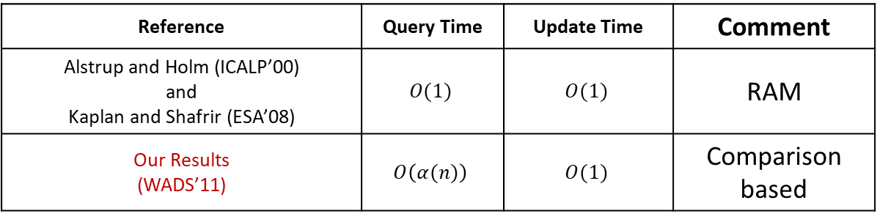
Dynamic Leaves
Reference | Query Time | Update Time | Comment
Alstrup and Holm (ICALP’00) and Kaplan and Shafrir (ESA’08) | $$O(1)$$ | $$O(1)$$ | RAM
Our Results (WADS’11) | $$O\left(α(n)\right)$$ | $$O(1)$$ | Comparison based
Optimal: Pettie (FOCS’02)
i
4
30
e
6
j
7
c
3
b
4
2
4
5
4
h
10
f
g
a
d
k

Slide 18
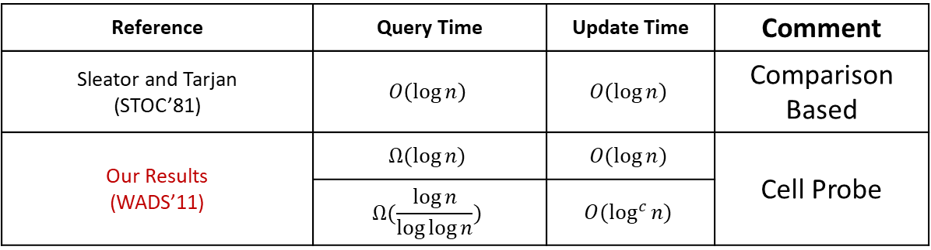
Updates with link and cut
i
4
cut(c,e)
30
e
6
j
7
c
3
b
4
2
link (d,i,12)
5
4
12
10
h
f
g
a
d
k
Reference | Query Time | Update Time | Comment
Sleator and Tarjan (STOC’81) | $$O\left(\log{n}\right)$$ | $$O\left(\log{n}\right)$$ | Comparison Based
Our Results (WADS’11) | $$Ω(\log{n)}$$ | $$O(\log{n})$$ | Cell Probe
 | $$Ω(\frac{\log{n}}{\log{\log{n}}})$$ | $$O(\log^{c}{n)}$$
Proof: by reduction from connectivity problems in graphs

Slide 19
Outline
Range Minimum Queries (ESA 2010, Invited to Algorithmica)
Path Minima Queries (WADS 2011)
Range Diameter Queries (Submitted to ISAAC 2011)
25 | 12 | 6 | 8 | 10 | 65 | 7 | 13
12 | 43 | 76 | 31 | 17 | 62 | 9 | 5
14 | 23 | 18 | 79 | 84 | 10 | 8 | 40
4 | 6 | 98 | 45 | 11 | 38 | 58 | 25
4
6
7
20
4
2
3
10
5
4

Slide 20

Range Diameter Queries
Farthest pair of points
A Difficult Problem

Slide 21

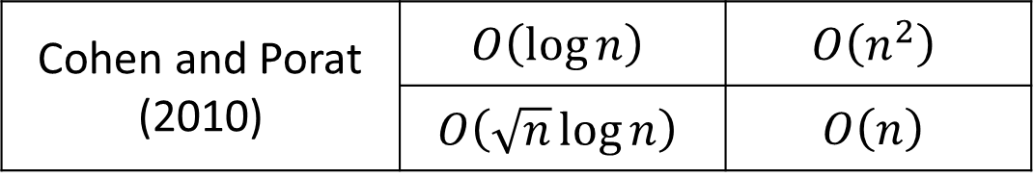
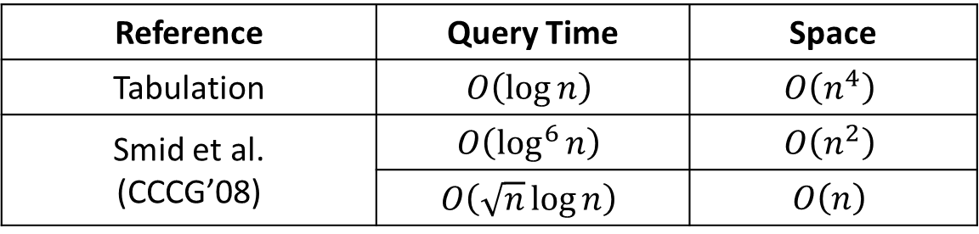
Known Results
Reference | Query Time | Space
Tabulation | $$O\left(\log{n}\right)$$ | $$O\left(n^{4}\right)$$
Smid et al. (CCCG’08) | $$O\left(\log^{6}{n}\right)$$ | $$O\left(n^{2}\right)$$
 | $$O\left(\sqrt{n}\log{n}\right)$$ | $$O\left(n\right)$$
Our Results (Submitted to ISAAC’11) | Reduction from Set Intersection
Set Intersection Problem
Cohen and Porat (2010) | $$O\left(\log{n}\right)$$ | $$O\left(n^{2}\right)$$
 | $$O\left(\sqrt{n}\log{n}\right)$$ | $$O\left(n\right)$$
Conjecture: Set Intersection problem is difficult
(Patrascu and Roditty, FOCS’10)

Slide 22






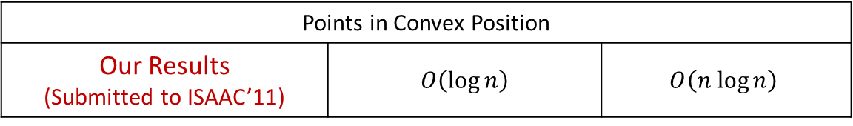


Set Intersection Queries Reduction
$$S_{1}=\left\{0.5,1,2\right\}$$
$$S_{2}=\left\{1,1.5,\sqrt{3}\right\}$$
$$S_{3}=\left\{0.2,3\right\}$$
Diameter = 3
$$S_{1}∩S_{2}≠∅$$
$S_{i}∩S_{j}=∅$ ?
Diameter < 5
$$S_{1}∩S_{3}=∅$$
$$4$$
$$2$$
$$1$$
$$S_{1}∩S_{2}≠∅$$
$$S_{1}∩S_{3}=∅$$
Arithmetic on real numbers with unbounded precisions
Reference | Query Time | Space
Points in Convex Position
Our Results (Submitted to ISAAC’11) | $$O\left(\log{n}\right)$$ | $$O\left(n log{n}\right)$$

Slide 23
Tries
Standard Tries
Compressed Tries
Suffix Tries

Slide 24
Text Processing
We have seen that preprocessing the pattern speeds up pattern matching queries
After preprocessing the pattern in time proportional to the pattern length, the Boyer-Moore algorithm searches an arbitrary English text in (average) time proportional to the text length
If the text is large, immutable and searched for often (e.g., works by Shakespeare), we may want to preprocess the text instead of the pattern in order to perform pattern matching queries in time proportional to the pattern length.
Tradeoffs in text searching

Slide 25
Standard Tries
The standard trie for a set of strings S is an ordered tree such that:
each node but the root is labeled with a character
the children of a node are alphabetically ordered
the paths from the external nodes to the root yield the strings of S
Example: standard trie for
the set of strings
S = { bear, bell, bid, bull,
buy, sell, stock, stop }
A standard trie uses O(n) space. Operations (find, insert, remove) take time O(dm) each, where:
-n = total size of the strings in S,
-m =size of the string parameter of the operation
-d =alphabet size,

Slide 26
Applications of Tries
A standard trie supports the following operations on a preprocessed text in time O(m), where m = |X|
-word matching: find the first occurence of word X in the text
-prefix matching: find the first occurrence of the longest prefix of word X in the text
Each operation is performed by tracing a path in the trie starting at the root

Slide 27
Compressed Tries
Trie with nodes of degree at least 2
Obtained from standard trie by compressing chains of redundant nodes
Standard Trie:
Compressed Trie:

Slide 28
Compact Storage of Compressed Tries
A compressed trie can be stored in space O(s), where s = |S|, by using O(1) space index ranges at the nodes

Slide 29
Insertion and Deletion into/from a Compressed Trie

Slide 30
Suffix Tries
A suffix trie is a compressed trie for all the suffixes of a text
Example:
Compact representation:

Slide 31
Properties of Suffix Tries
The suffix trie for a text X of size n from an alphabet of size d
-stores all the n(n-1)/2 suffixes of X in O(n) space
-supports arbitrary pattern matching and prefix matching queries in O(dm) time, where m is the length of the pattern
-can be constructed in O(dn) time

Slide 32
Tries and Web Search Engines
The index of a search engine (collection of all searchable words) is stored into a compressed trie
Each leaf of the trie is associated with a word and has a list of pages (URLs) containing that word, called occurrence list
The trie is kept in internal memory
The occurrence lists are kept in external memory and are ranked by relevance
Boolean queries for sets of words (e.g., Java and coffee) correspond to set operations (e.g., intersection) on the occurrence lists
Additional information retrieval techniques are used, such as
stopword elimination (e.g., ignore “the” “a” “is”)
stemming (e.g., identify “add” “adding” “added”)
link analysis (recognize authoritative pages)

Slide 33
Tries and Internet Routers
Computers on the internet (hosts) are identified by a unique 32-bit IP (internet protocol) addres, usually written in “dotted-quad-decimal” notation
E.g., www.cs.brown.edu is 128.148.32.110
Use nslookup on Unix to find out IP addresses
An organization uses a subset of IP addresses with the same prefix, e.g., Brown uses 128.148.*.*, Yale uses 130.132.*.*
Data is sent to a host by fragmenting it into packets. Each packet carries the IP address of its destination.
The internet whose nodes are routers, and whose edges are communication links.
A router forwards packets to its neighbors using IP prefix matching rules. E.g., a packet with IP prefix 128.148. should be forwarded to the Brown gateway router.
Routers use tries on the alphabet 0,1 to do prefix matching.

Slide 34
THANK YOU
For queries
Email: Rahul.e10843@cumail.in

